Slide 1

AIRPORT COMMERCIAL DEVELOPMENT
AIRPORT RETAIL OPERATIONS
PRESENTED BY: JOHN ITALUME

Slide 2
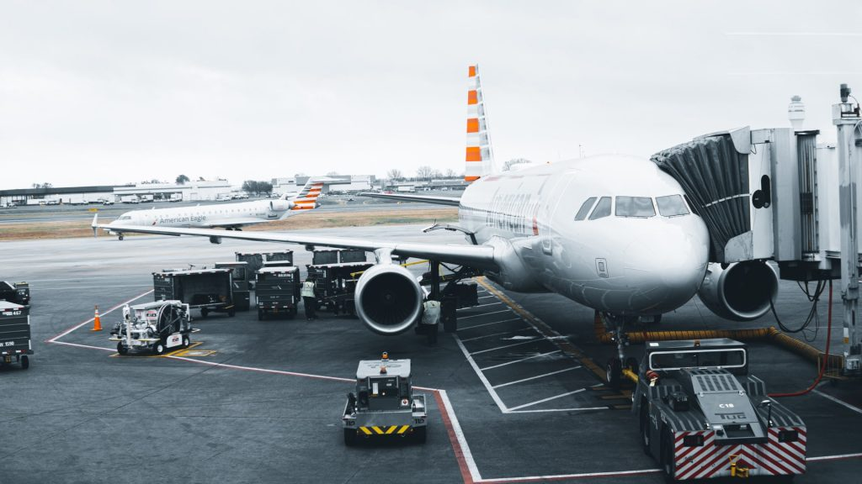

Introduction
Airport operations are designed to be revenue generating as well as ensuring efficient services to Airport users. Even though these operations are regulated by the International Civil Aviation standards they are also subject to policies made by the state. These policies helps in developing the commercial business in an Airport as it is a source of revenue to the sustainability of the Airport.The non-aeronautical source of revenue is a significant aspect of revenue to the sustenance of the Airport business as they are numerous sources that are not directly charged on the passengers. These revenues are generated from retail, parking, food and beverage concessions and other activities.

Slide 3

Introduction cont.
Airport retail operations can be described as the availability of retail services of various products within the Airport in order to provide greater convenience to airport users. The Airport retailing business is usually driven by the number of passengers and other Airport users however, recent technological advances had made retail business to be exposed to electronic means of trading such as on-line and e-commerce platform thereby making the business accessible to non-airport customers. These platforms do not only benefit the non- airport users but also has the capacity of improving sales of the retail business owners.

Slide 4
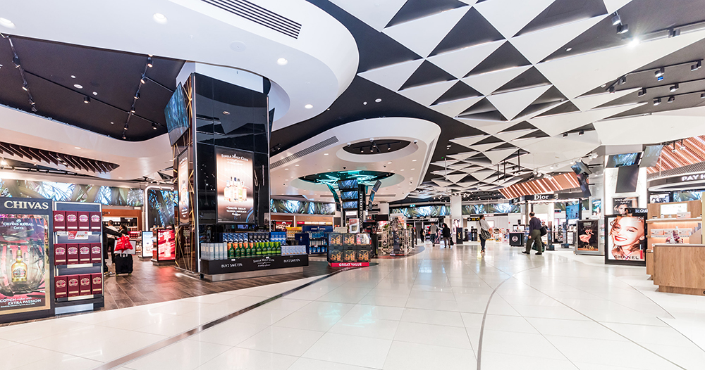

Retail Contracting practices
Contracting prctices are various level of agreements or concessions which grant liscence by the management to the private sector to operate the business for a specified period within specified terms and conditions. The management of Airport retail business involves the implementation of strategies which may involve certain contracting practices. These contracting practices are;
1. Joint venture agreement
2.Master concession agreement
3. Service level agreement
4. Specific concession agreement

Slide 5


Forces of change
The retail business has generally been influenced by multinationals such as Google, Amazon, Alibaba etc. these multinational stores are giants in the digital space in influencing the retail market as well as the industry. Some of the identified forces of change that may impact on the operations of Airport retail business are:
The digital wave
Modern trends and Advertising
E-commerce
Government policies
Market structure

Slide 6

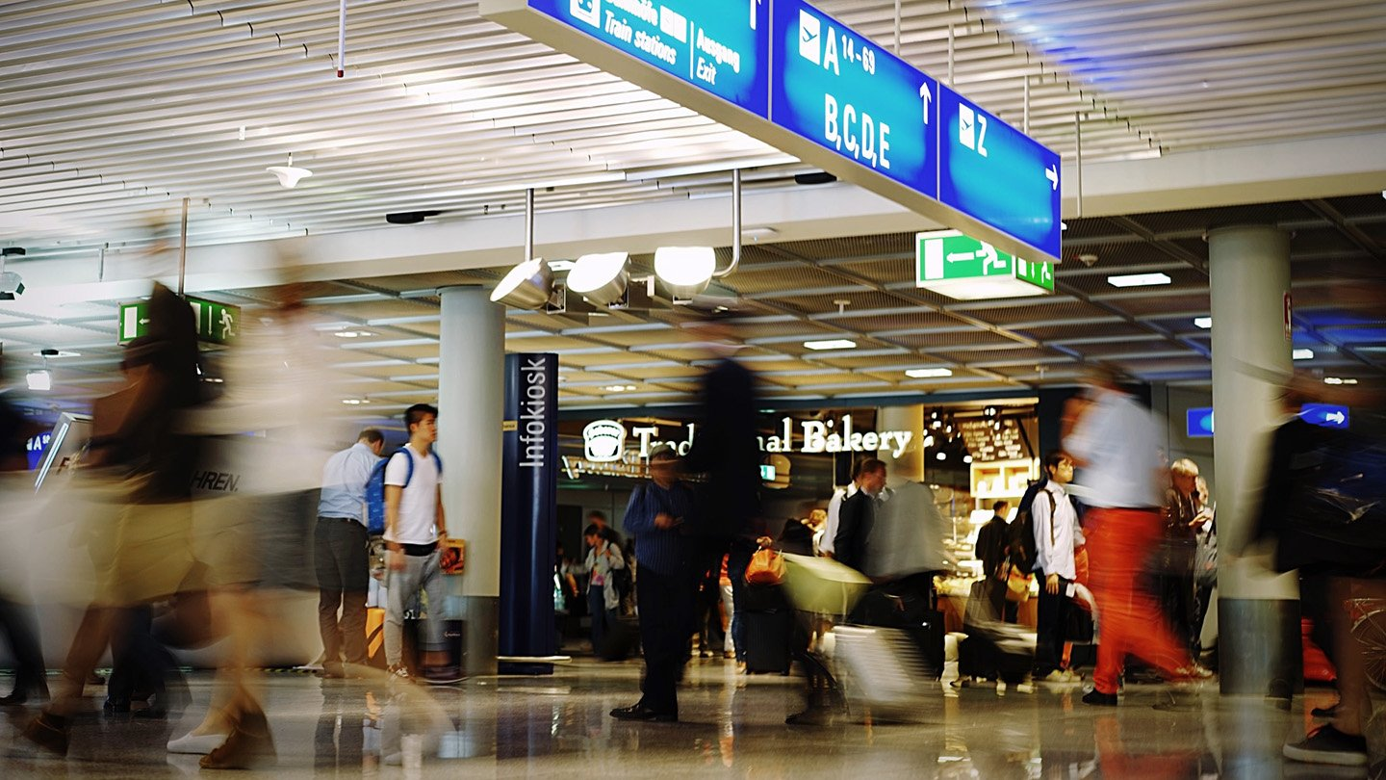
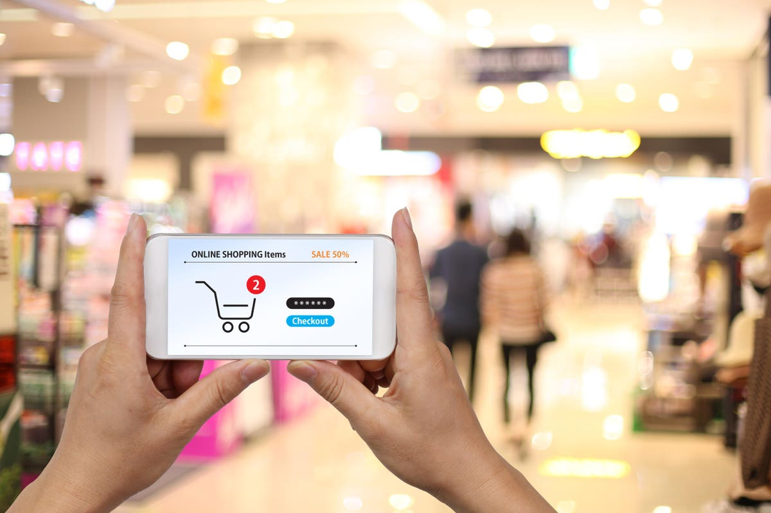
Management response
Digitilization is creating new business and disrupting existing ones every single day. This force of change can not be undermined hence it is necessary that Airports adopt the digital space as this will enable operators in the retail business at the airport drive in traffic to their business and compete favorably with other market operators.
Modern Trends. During the economic crisis, Luxury fashion, beauty and liquor brands were popular with affluent travelers. These products form the most demanded commodities in most retail stores among travelers. Airport retail business will need to create a favorable market environment alongside policies that will encourage modern trends to be accessible by passengers at the Airport.

Slide 7


Management response cont…
Brand awareness is also important by the management of the Airport however, there is need to have a clear position and also ensure consistency by all retail operators in the Airport.
Management need to engage the operators of retail business and communicate decisions and policies made by the Airport management towards increasing revenue generation. Improving security and reducing uncertainties is very crutial for the Airport management to implement alongside ensuring there is a convenient environment to operate.
Management will have to develop a sustainable commercial program that will review the retail operations in the Airport and will also ensure an efficient integration of the digital space in ensuring technological advancement in the retail business.

Slide 8

Impact of policies and Industry changes
Policies are usually implemented to regulate or review certain programs or business decisions that are adopted by an organization. The aim and objective of management policy in Airport commercial development is to ensure the optimization of revenue generation. This also involve price cap regulations, cost of service regulations, long term contracts and some other economic regulations. The impact of these regulations alongside Industry changes can also create challenges in Airport retail management. This is evidence from the recent pandemic which led to a lock down in most economies in the world. Airport retail business encountered severe loss in revenue and shut-down operations which led to loss of jobs and contracts in the industry.

Slide 9

Airport Retail and Facilitation
It is very critical as it describes the ability for the users to meet their satisfaction. The needs and expectations helps in meeting commercials through the flows of goods and services however, Airport facilitation does not manage concessions but work indirectly with other aspect of the Airport to ensure the efficient flow of retail businesses alongside improving the revenue for the Airport.
In ensuring the efficient operations of retail commercial business in the Airport, facilitating these retail activities helps in ensuring passengers needs and expectations are met and ensure satisfaction.

Slide 10

Conclusion
Airport commercial development plan identifies long-term strategies and aims at creating structures that will ensure economic sustainability of the Airport. This is achieved by implementing a holistic commercial plan which will ensure an efficient tariff system alongside sustainable market structure.

